Slide 1

MSCI 311
Organizational Design and Technology
Instructor: Ayman Alzayat, aalzayat@uwaterloo.ca
TA: Varsha Suryanarayana, vsuryana@uwaterloo.ca

Slide 2
Organizational environment
Environmental Uncertainty
Complexity
Stability
Burns & Stalker
Restructure
Managing Environmental Uncertainty
Lawrence & Lorsch
Other internal and external actions
Chapter 3 overlap

Slide 3
What constitutes an organization’s environment?
General environment: all factors that can potentially influence all or parts of the organization)
Ecological
Cultural
Economic
Legal
Sociological
Political
Market

Slide 4
What constitutes an organization’s environment?
Task environment: Subset of all factors that are relevant to organizational goal setting and goal attainment
(I.e., factors of the general environment that are of concern to the organization)
Example: customers, suppliers, competitors, government

Slide 5
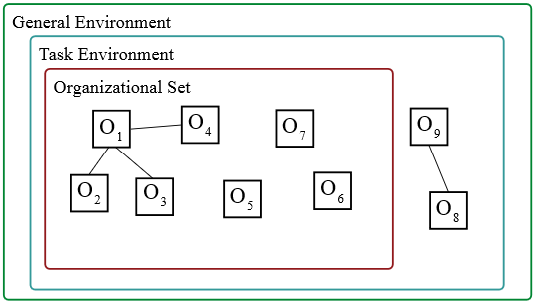
What constitutes an organization’s environment?
Organizational set: Set of other organizations in the task environment, with which the organization interacts:
Interactions take many forms like (co-operative vs. competitive)
Examples:
Joint ventures, alliances, licensing arrangements, supply chain, etc.

Slide 6
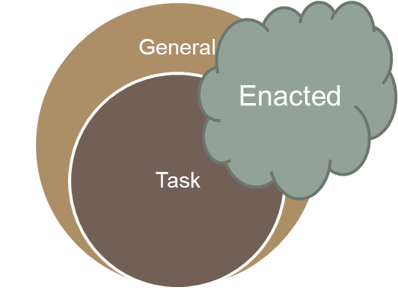
What constitutes an organization’s environment?
Enacted environment: Portion of the environment that is perceived and acted upon.
The same actual external environment can be perceived (and thus, acted upon) differently by different managers.
WHY?

Slide 7
What is environmental uncertainty?
Recall previous definition of uncertainty
Uncertainty = Information needed – Information that is available
Two variables of environmental uncertainty
Complexity
Number and heterogeneity of external elements that affect the organization to make a decision.
Stability (or dynamism)
Unpredictability of changes that affect the organization.
Magnitude and rate of change of the elements.

Slide 8
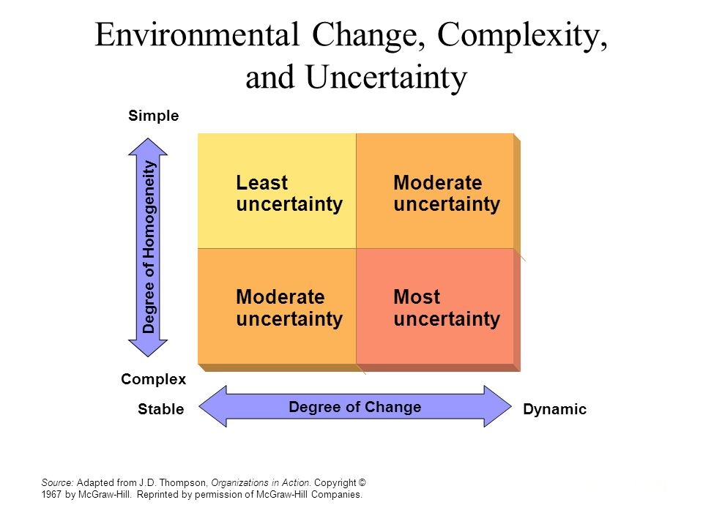
What is environmental uncertainty?
Low
Complexity
High
Complexity
High
Stability
Low
Stability

Slide 9
What is environmental uncertainty?
 | Simple | Complex
Static | Soft Drink | Food
Dynamic | Fast food | Airline

Slide 10
How do organizations manage environmental uncertainty?
Internal Actions
Development of more organic structures (Burns & Stalker studies).
By managing differentiation levels.
Boundary Spanning Units.
Creation of Self- Contained Units.
Information Management
Buffering the organization from the source of uncertainty
Smoothing / levelling
Imitating other firms

Slide 11
How do organizations manage environmental uncertainty?
External Actions
Direct influence.
Indirect influence.
Controlling the environment.

Slide 12
How do organizations manage environmental uncertainty? Internal Actions
1- Development of more organic structures (Burns & Stalker studies)
Historical background:
Burns & Stalker studied electronics firms in Britain in the 50s
Within each firm, they focused on two functional units:
Manufacturing
Research & development (R&D)
They observed two emerging types of structures: mechanistic and organic.
Both types are rational
Deliberately created and maintained to use human resources efficiently

Slide 13
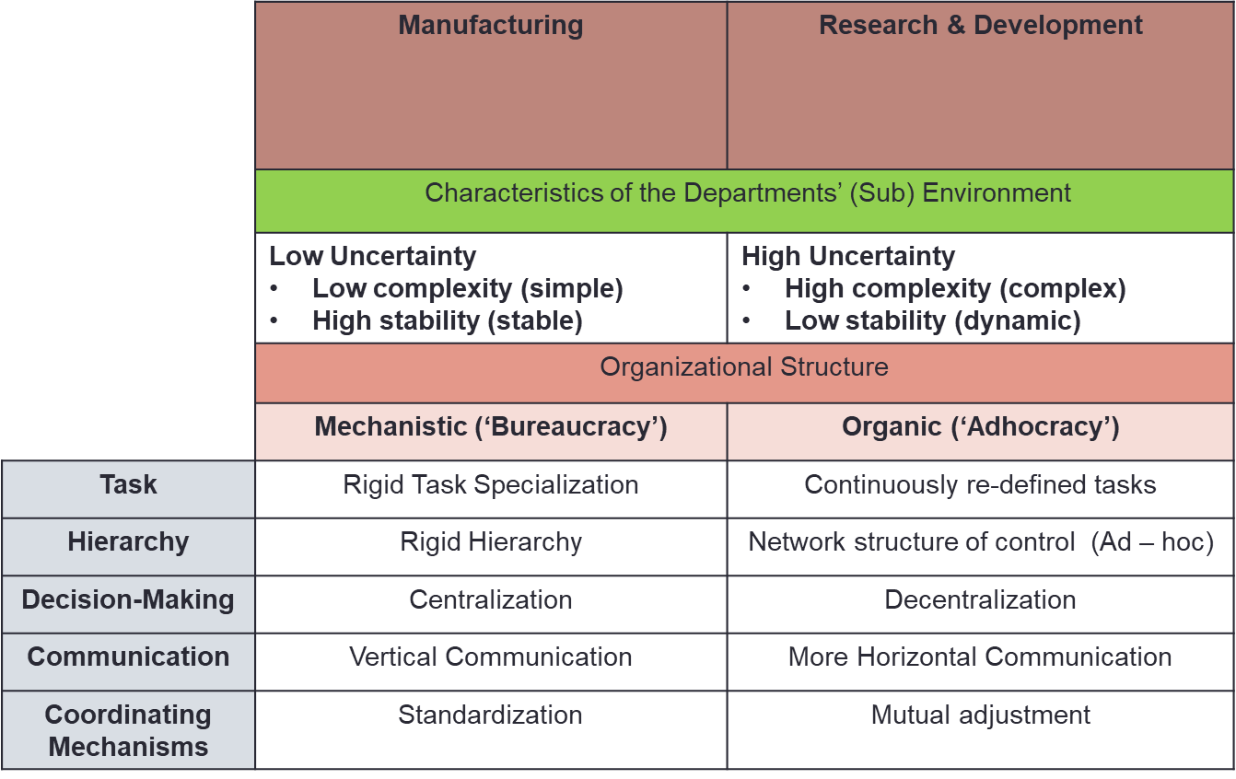
How do organizations manage environmental uncertainty? Internal Actions

Slide 14
How do organizations manage environmental uncertainty? Internal Actions
2- By managing differentiation levels
Historical background
Lawrence and Lorsch studied high-performing firms in three industries
Plastics
Industrial foods
Containers
Within each firm, they studied three functions (departments)
Manufacturing
Research & Development
Sales

Slide 15
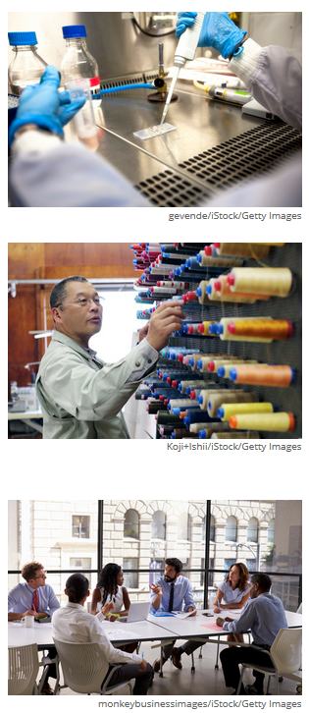
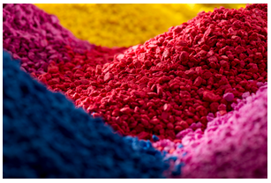
How do organizations manage environmental uncertainty? Internal Actions
Lawrence and Lorsch – Study 1
Study of 4 variables:
Level of formalization
Planning time horizon
Primary goals
Interpersonal orientation

Slide 16
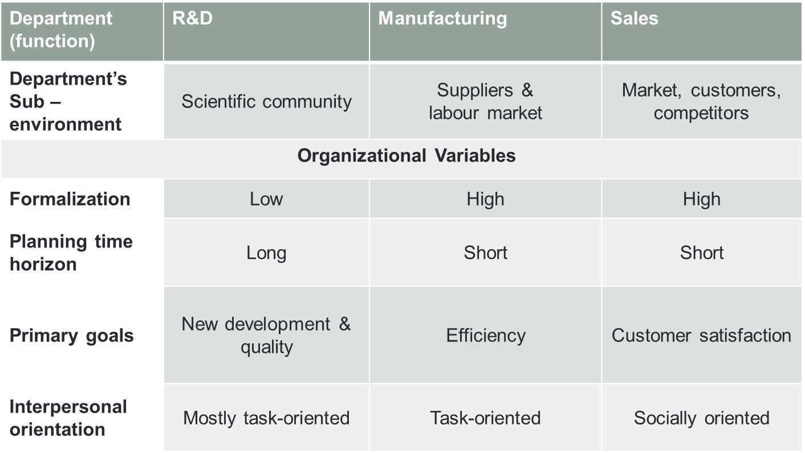
How do organizations manage environmental uncertainty? Internal Actions
Lawrence and Lorsch – Study 1
Study 1: Difference between functions in the firms in the plastics industry

Slide 17
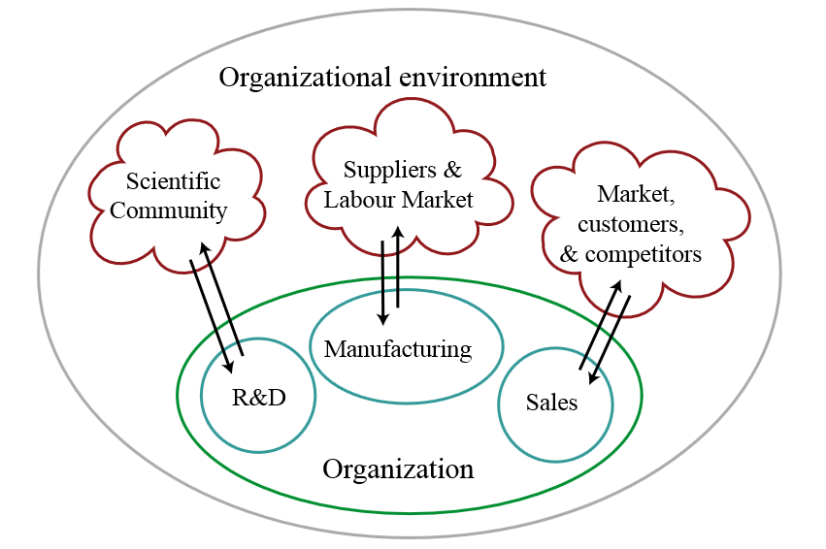
How do organizations manage environmental uncertainty? Internal Actions
Lawrence and Lorsch – Study 1

Slide 18
How do organizations manage environmental uncertainty? Internal Actions
Lawrence and Lorsch – Study 1
Research & Development
“We very often know the performance characteristics required by a customer or for a new application, but as far as research is concerned, you might as well be asking for the perfect plastic. We have to be concerned with technical feasibility right from the start, and then you don’t know as you are involved in a lengthy testing and development process”
“The development of plastics materials is more of an art than a science. We often don’t fully understand what is needed to meet customer requirements, and if we do, we don’t know how we can process it.”
Manufacturing & Other quotes:
“In production, life is really plain, as it is geared to running the kind of plan and equipment which they currently have and where most of the decisions are built in.”
“The requirements in this industry are that you must have good and continuing technology, sound economics in your production, and you must market your product at the lowest costs. I’d say these are all equal. But first among equals, and the most critical, are the research and marketing areas. I would say that they are the most critical and the most difficult because there are so many variables involved. You know what you are doing in production. You have the facts there”

Slide 19
How do organizations manage environmental uncertainty? Internal Actions
Lawrence and Lorsch – Study 1
Different task situations are associated with different ‘sub-environments’ for different functional specialists
Different sub-environments lead to different ways of organizing activities
L & L called this differentiation of departments, meaning a difference in orientation of the management in each department, which is reflected in the different structures (formalization, planning time horizon, goals, and interpersonal orientation)
Not just related labour division and coordination; includes unique perceptions, goals, values, etc.

Slide 20
How do organizations manage environmental uncertainty? Internal Actions
Lawrence and Lorsch – Study 1
High differentiation <-> different departments have different structures and orientations
Leads to coordination issues
Low differentiation <-> different departments have similar structures and orientations
How do you solve the coordination problem?
Improve integration = Extent of collaboration between departments that are required to achieve unity of effort by the demands of the environment

Slide 21

How do organizations manage environmental uncertainty? Internal Actions
Lawrence and Lorsch – Study 2

Slide 22
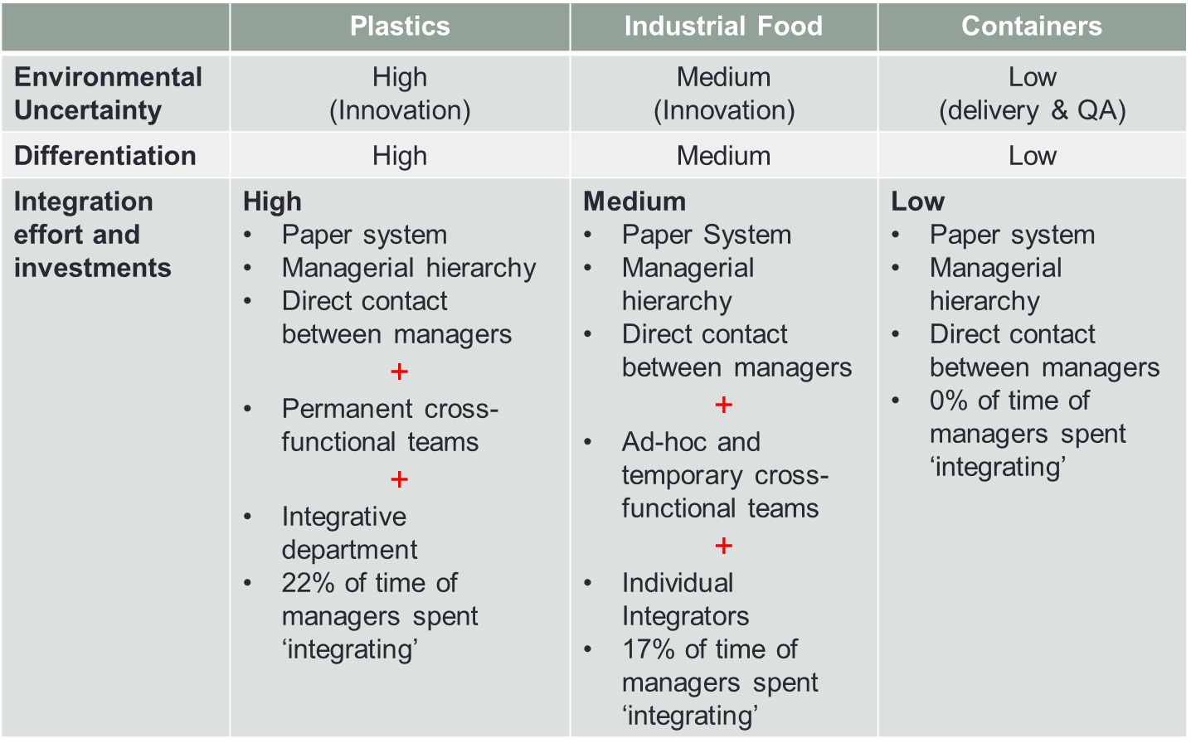
How do organizations manage environmental uncertainty? Internal Actions
Lawrence and Lorsch – Study 2
Study 2: Differences in differentiation and integration between industry sectors

Slide 23
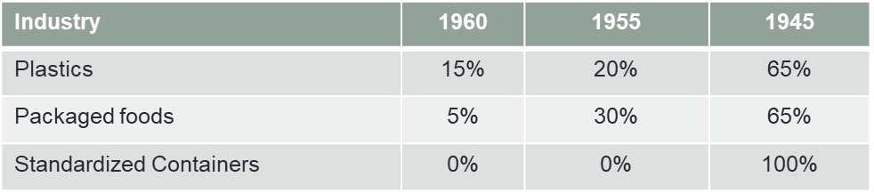
How do organizations manage environmental uncertainty? Internal Actions
Lawrence and Lorsch – Study 2
The level of innovation created differed by industry.
E.g., By 1960, the ‘containers’ industry was using technology and innovation that had been discovered before 1945
In contrast, in 1960, 15% of technology and innovation that the ‘plastics’ industry was using had been discovered that same year.

Slide 24
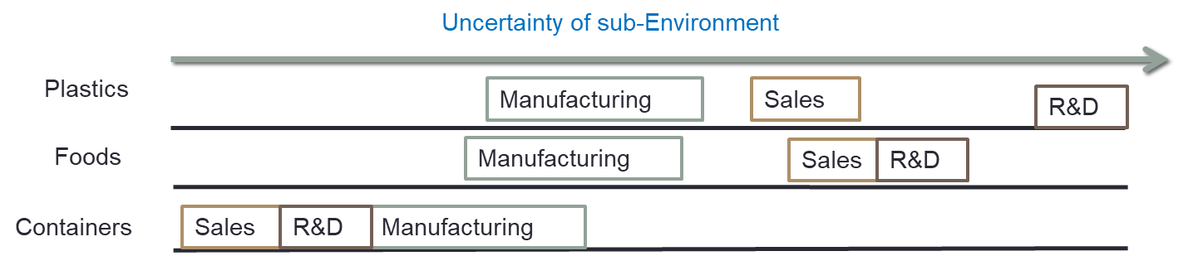
How do organizations manage environmental uncertainty? Internal Actions
Lawrence and Lorsch – Study 2
Within and across industries, we can observe the relative uncertainty of (sub)environment faced by each functional unit

Slide 25
How do organizations manage environmental uncertainty? Internal Actions
Lawrence and Lorsch – Study 2
Higher overall environmental uncertainty for an organization is best matched with high departmental differentiation
For an organization to succeed, high departmental differentiation must be matched with high integration levels

Slide 26

Org. Environments | Managing Uncertainty
Remember contingency theory?
Optimum org. structure = f(environmental uncertainty)

Slide 27
How do organizations manage environmental uncertainty? Internal Actions
3- Boundary Spanning Units
Collect information about environmental changes and represent the organization to outside agencies
‘Control’ how the organization is perceived
Examples: public relations, market researchers, etc.
Environment
Organization
Boundary Spanners

Slide 28
How do organizations manage environmental uncertainty? Internal Actions
4- Creation of Self-Contained Units
Created ad-hoc to respond to emerging issues
Examples: PDENG Task Force
Environment
Organization
High Uncertainty
Self – Contained Unit

Slide 29
How do organizations manage environmental uncertainty? Internal Actions
5- Information Management
Improved planning and forecasting
E.g., increased mall store hours during the holiday season
Investment in Information Systems
E.g., CRM, ERP, KMS
Data Analytics as emerging field

Slide 30
How do organizations manage environmental uncertainty? Internal Actions
6- Buffering the organization from the source of uncertainty
Uncertainty in inputs
E.g. maintain larger inventories of raw materials
Uncertainty in outputs
E.g. produce more than necessary
Increase organizational slack
E.g. employ more workers, less than full utilization of production capacity, lengthening lead time
Downside: increased costs. WHY?

Slide 31

How do organizations manage environmental uncertainty? Internal Actions
7- Smoothing / levelling
Attempts to reduce uncertainty in demand
Example: SmartMeters

Slide 32
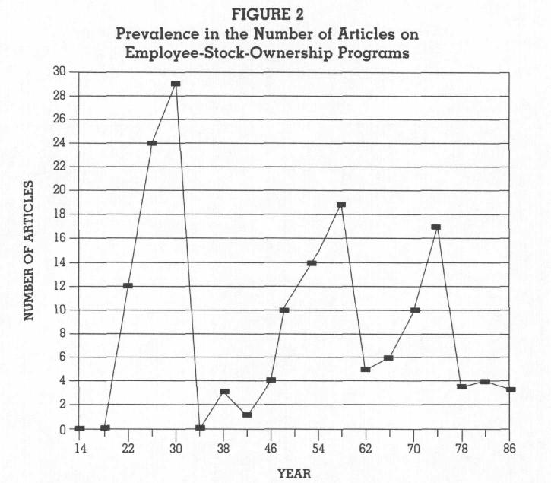
How do organizations manage environmental uncertainty? Internal Actions
8- Imitating other firms
Organizational fashion
Example: employee-stock-ownership programs

Slide 33
How do organizations manage environmental uncertainty? External Actions
1- Direct influence
Establishing inter-organizational linkages
Ownership/control of supply chain: e.g. suppliers, distributers, customers
E.g., Toyota, Walmart
Merge with or acquire competitor
E.g., Sybase & SAP

Slide 34
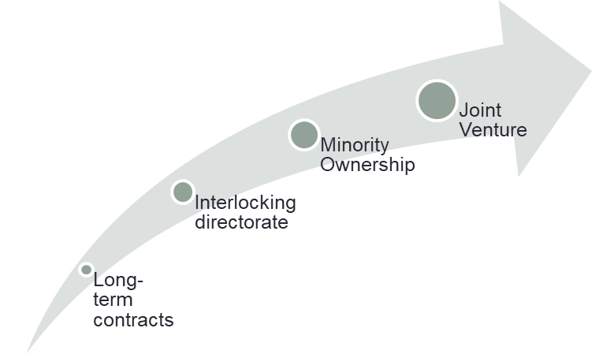
How do organizations manage environmental uncertainty? External Actions
2- Indirect influence
Strategic Alliances – agreement to share resources for mutual benefit
Joint Ventures – creation of a new org. entity
Example: Sony Ericsson Mobile Communications
Long-term contracts – to reduce risk and cost
Example: Energy buying groups

Slide 35
How do organizations manage environmental uncertainty? External Actions
3- Controlling the environment
Bargaining – with other organizations
E.g., GM bailout
Public relations programs and political strategies
E.g., lobbying
Cause marketing and social activism
E.g., CIBC Run for the Cure
Illegal activities
E.g., price fixing

Slide 36
Org. Environments | Summary
Definition of Environment: general, task, enacted
Environmental Uncertainty: complexity, stability
Managing Environment Uncertainty
Internal Actions
Making organizations more organic (Burns & Stalker)
Managing differentiation levels (Lawrence & Lorsch)
Boundary spanning units & self-contained units
MIS, buffering, smoothing, rationing, imitating
External Actions
Direct/indirect control over the source of uncertainty
Controlling the environment

